Slide 1
React JS
Prepared by: Vijaya Tiple

Slide 2
Handling Events
Handling events with React elements is very similar to handling events on DOM elements. There are some syntactic differences:
React events are named using camelCase, rather than lowercase.
With JSX you pass a function as the event handler, rather than a string. For example, the HTML:

Slide 3
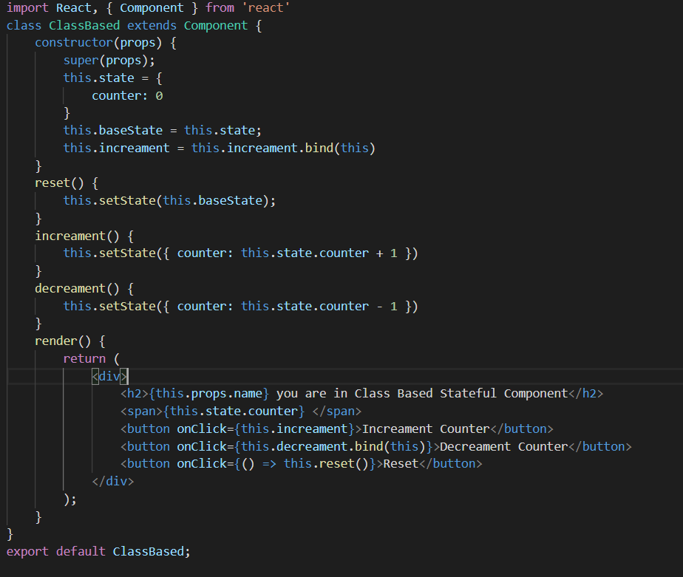
Event handling example

Slide 4

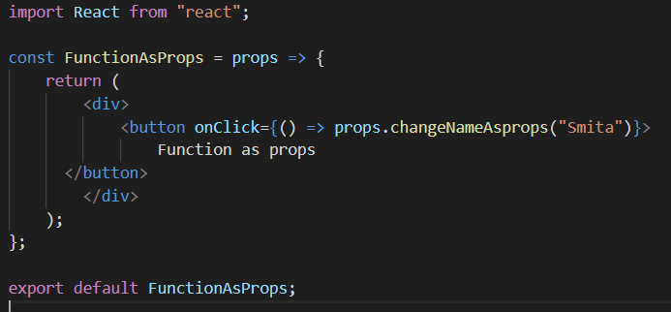
Function as props
You can always pass a function as props.
With this, you will be able to call the parent function inside a child component.
This feature is very helpful when you want to pass some data from child to parent or update the parent state from child component.
Passing a function as props from parent component.
Calling the props function

Slide 5
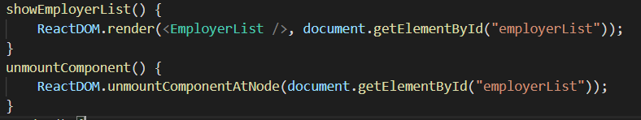
ReactDOM // Deprecated
Sometimes, you want to render /remove some component on event click or after some JavaScript execution. At that time, reactDOM methods we can use
The react-dom package provides DOM-specific methods that can be used at the top level of your app.
render() & unmountComponentAtNode
unmountComponentAtNode()

Slide 6
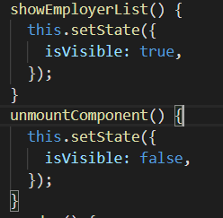
Mounting and unmounting in React 18+
Sometimes, you want to render /remove some component on event click or after some JavaScript execution. At that time, we can use conditional state variable.
Find below example:

Slide 7
Assignment
Assignmet1:
Create 4 component animals, users, employees and birds. Set the component name and information with useState hook.
Create LivingThings component with 4 buttons animals, users, employees and birds, on click of each button should open the corresponding component (topics event handling, mounting and unmounting in React 18+, list keys)
Assignment2:
Create 4 component animals, users, employees and birds. Set the component name and information with props
Create LivingThings component with 4 buttons animals, users, employees and birds, on click of each button should open the corresponding component (topics event handling, mounting and unmounting in React 18+, list keys)

Slide 8
Assignements
Assignment3:
Create 4 component animals, users, employees and birds using stateful class component
Create LivingThings component with 4 buttons animals, users, employees and birds, on click of each button should open the corresponding component (topics event handling, mounting and unmounting in React 18+, list keys)
Assignmet4:
Create a counter example using functions as props. child component should have a button to update the counter value in parent component.

Slide 9
Thank you!

